Slide 1
Introduction to Hadoop
Pravin Y Pawar

Slide 2
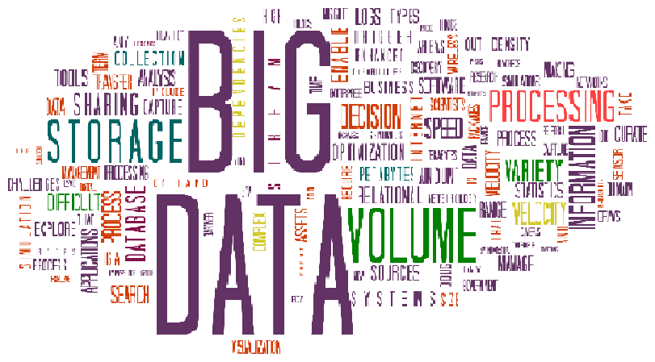
Big Data Challenges
Volume, Variety and Velocity
“How to store terabytes of mounting data?”
VOLUME
“How to handle structured, semi-structured and unstructured data?”
VARIETY
“How to manage the data that is getting generated at very fast speed?”
VELOCITY
Image Source : amcham

Slide 3
Why Hadoop?
Key consideration
Hadoop can handle
Massive amount of data
Different kinds of data
In fast manner
Advantages
Low cost – open source
Computing power – many nodes can be used for computation
Scalability – simple to add nodes in system
Storage Flexibility – can store unstructured data easily
Inherent data protection – protects against hardware failures

Slide 4
Distributed Computing Challenges
Problems and Solutions
Storage of huge amount of data
More systems , more failures
How to retrieve the data stored on the failed node?
Hadoop solves this by Replication Factor (RF)
Number of data copies of a given data item / data block stored across the network
Processing the huge amount of data
Data is spread across systems, how to process it in quick manner?
Challenge is to integrate data from different machines before processing
Hadoop solves this by MapReduce Programming
Programming model to process huge amount of data at same time in quick manner

Slide 5
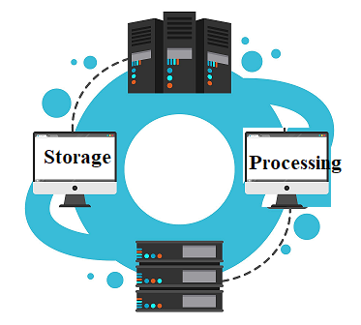
What is Hadoop?
Key Aspects
Two Tasks
Massive Data Storage
Huge of amount of data across several nodes
Uses low cost commodity storage
Faster Data Processing
Has everything needed for data processing application development
Computation done parallel on several nodes at same time

Slide 6
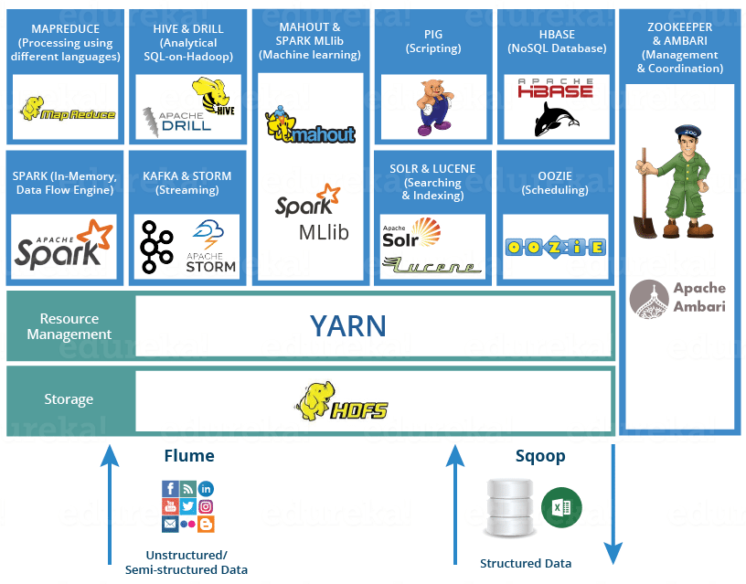
Hadoop Ecosystem
Image Source : Edureka

Slide 7
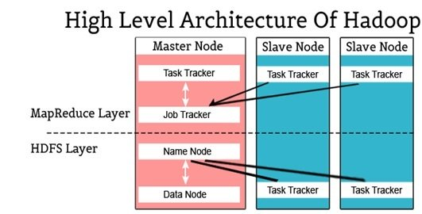
Hadoop High Level Architecture
Image Source : intellipaat

Slide 8
Thank You!
In our next session: Cloud Computing for Big Data

